Slide 1
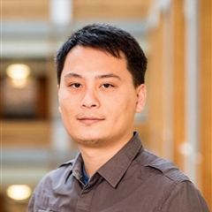
Pre-trained Summarization Models of Structured Datasets for Cardinality Estimation
Yao Lu, Srikanth Kandula, Arnd Christian Konig, Surajit Chaudhuri
Microsoft Research
VLDB 2022

Slide 2
Cardinality Estimation (CE) is a key task in QO
Query
predicates
Test time
Dataset / Workload
Training
Model
Cardinality
Recent ML-enhanced CE solutions train a model
Per dataset: Naru (VLDB 20), DeepDB (VLDB 20), FLAT, NeuroCard(VLDB 21).
Per workload: MSCN (CIDR 18), LM (VLDB 19, 20), CLEO (SIGMOD 20).
Often: Take hours to collect data, compute labels & train models.
Re-train when dataset/workload changes.

Slide 3
Cardinality Estimation (CE) is a key task in QO
CE in production systems uses histograms & sketches:
Fast to build & query: 10-100 $μ$s per CE call.
Production systems often hold 10s-100s datasets.
Training & managing a model per dataset/workload $→$ not affordable.
Goals for ML-enhanced CE:
Small building latency per dataset/workload
Adapts to changes quickly.
Sub-ms latency per CE call.
High accuracy.

Slide 4
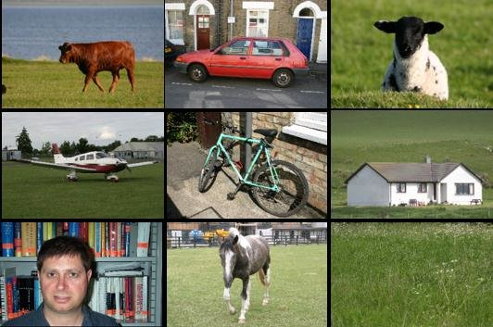
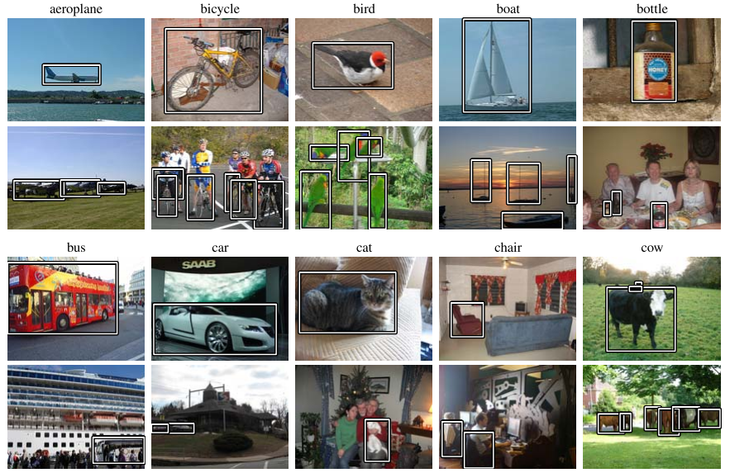
AI in the last decades: shifts to pre-trained models
Object detection: per dataset model
MSRC dataset (2005): 240 images, 9 object classes
PASCAL VOC Challenge (2005-2012): Ks images, 10s classes
Pre-training on large dataset
(Deep) models: AlexNet (2013), ResNet (2015), MobileNet (2018),...
Dataset: LabelMe (50K), ImageNet (14M), MS COCO (33M),…
Pre-training for structured data?
Move costs to pre-training
& learn common patterns.

Slide 5
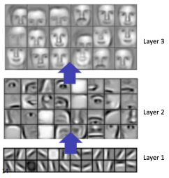
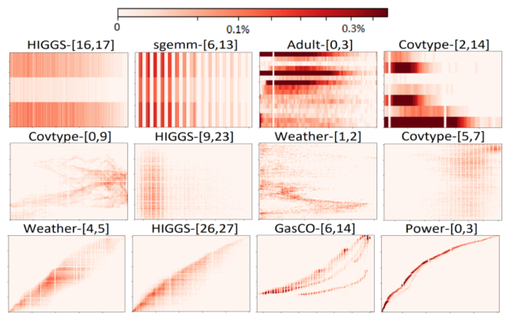
What to learn in pre-training?
Images and text have common patterns
Accurate CE depends on:
Frequency distribution & correlation
patterns in structured datasets.
Example
(L_ commitdate, L_ shipdate, L_receiptdate)
Summary
CE
Shipdate > 10/30/2010 Predicate

Slide 6
Pretrained models for structured data?
Pre-training stage (offline)
Table
encoding
model
CE
model
CE
Label
Embedding
(summary)
Training
corpus

Slide 7
Pretrained models for structured data?
Building stage
Table
encoding
model
CE
model
New table w/
arbitrary schema
Embedding
(summary)
Use the models off-the-shelf
No per dataset/workload training
Small building latency

Slide 8
Pretrained models for structured data?
Querying stage (CE)
Table
encoding
model
CE
model
Prediction
New table w/
arbitrary schema
Embedding
(summary)
Query
predicate
Use the models off-the-shelf
No per dataset/workload training
Small building and
Analogy: learning to “sketch” from data
Related work: sketches, multi-dim histograms
More compact summaries & broader output functions
query latency @ high accuracy

Slide 9
Challenge in encoding structured data
To encode structured data w/ arbitrary schema
ML models take fixed-sized inputs.
One-hot encoding cannot work for arbitrary schema
Infinite schemas $→$ a model for each / all schemas is both impossible.
 | Images | Text | Structured datasets
Raw input size | W x H pixels | n words | arbitrary #rows
Raw input type | Pixels | Tokenized words | Arbitrary #cols, data type, #dv
Order invariance | Sensitive to pixel position | Sensitive to word position | Invariant of row & col order
Updatability | X | X | Often needed
Mergeability | X | X | Often needed

Slide 10
Iris for structured dataset summarization & CE
Key ideas & contributions
Decompose into low-dim sub-relations
New quantization scheme.
Pre-trained summarization & CE models
Linearly mergeable & updatable summaries.
Model inference only.
Use simple models & SIMD.
Goals & Challenges
High-dim & arbitrary schema
Accuracy & latency
No per dataset training
Quickly adapt to changes
Small building & query latency
High accuracy
Train a small
# of models
Adapting Deep
Sets (M. Zaheer
et al. NeurIPS17)
(empirical)

Slide 11
Summarization & CE pipeline
Columnsets Corr. score Bag of summaries
(Col2) -
(Col3, Col4) 0.30
(Col1, Col4) 0.01
…
CORDS.
Pre-proc
Encoding
Histogram
Iris summary
Sparse repr.
…
Card. Estimator
Result
Table w/
arbitrary schema
Query (Col1,3,4)
Decompose into low-dim sub-relations using CORDS [Ilyas et al. SIGMOD 04].
Given a storage budget for summarization:
Summarize only “important” sub-relations: high correlation score & #DV.
Choose summarization techniques including pre-trained models.
To answer a CE query,
Assemble results from a bag of summaries.
Scope of tables & queries
Inputs: cat. / real columns from a single table/relation.
Predicates: conjunction of point & range checks.

Slide 12
Iris models: conditional auto-encoder
Column 1 Column 2 Column d
$c_{1}^{1}$ $c_{1}^{2}$ $c_{1}^{d}$
.. .. ..
$c_{n}^{1}$ $c_{n}^{2}$ $c_{n}^{d}$
$$φ_{r}$$
..
Encoder
Row embeddings
$→$ Quantize
$→$ Cell embedding
$→$ $φ_{c}$($c_{1}^{1}$)
$→$ Quantize
$→$ Cell embedding
$→$ $φ_{c}$($c_{1}^{2}$)
$→$ Quantize
$→$ Cell embedding
$→$ $φ_{c}$($c_{1}^{d}$)
[$φ_{c}(c_{1}^{1})$,.., $φ_{c}(c_{1}^{d})$]
$ψ$($s_{1}$)
..
Element-
wise add
$$\text{⊕}$$
Data summary $ψ$(S)
…
…
Normalize
..
..
[$φ_{c}(c_{n}^{1})$,.., $φ_{c}(c_{n}^{d})$]
$ψ$($s_{n}$)
Input each row $s∈S$
Summary
Example: Add a row
Mergeability & updatability:
Add row
Delete row
Update row
[$c_{r}^{1}$,…,$c_{r}^{d}$]
Row r to add
Pre-trained
encoding
model
Summ. of r.
$$\text{⊕}$$
New summ.
Prev summ.

Slide 13
Iris models: conditional auto-encoder
Column 1 Column 2 Column d
$c_{1}^{1}$ $c_{1}^{2}$ $c_{1}^{d}$
.. .. ..
$c_{n}^{1}$ $c_{n}^{2}$ $c_{n}^{d}$
$$φ_{r}$$
..
Encoder
Row embeddings
Eval($S, p$)
$→$ Quantize
$→$ Cell embedding
$→$ $φ_{c}$($c_{1}^{1}$)
$→$ Quantize
$→$ Cell embedding
$→$ $φ_{c}$($c_{1}^{2}$)
$→$ Quantize
$→$ Cell embedding
$→$ $φ_{c}$($c_{1}^{d}$)
[$φ_{c}(c_{1}^{1})$,.., $φ_{c}(c_{1}^{d})$]
$ψ$($s_{1}$)
..
$$φ_{1}$$
$$φ_{3}$$
Element-
wise add
Data summary $ψ$(S)
$$\text{⊕}$$
Normalize
…
…
..
..
[$φ_{c}(c_{n}^{1})$,.., $φ_{c}(c_{n}^{d})$]
$ψ$($s_{n}$)
Input each row $s∈S$
Query predicate ${p=[p}_{l}, p_{h}]$
$c_{p_{l}}^{1}$ $c_{p_{l}}^{2}$ $c_{p_{l}}^{d}$
$c_{p_{h}}^{1}$ $c_{p_{h}}^{2}$ $c_{p_{h}}^{d}$
Decoder
$→$ Quantize
$→$ Cell embedding
$→$ $φ_{c}$($c_{p_{l}}^{1}$)
$→$ Quantize
$→$ Cell embedding
$→$ $φ_{c}$($c_{p_{l}}^{2}$)
$→$ Quantize
$→$ Cell embedding
$→$ $φ_{c}$($c_{p_{l}}^{d}$)
$$φ_{r}$$
$$φ_{2}$$
..
[$φ_{c}(c_{p_{l}}^{1})$,.., $φ_{c}(c_{p_{l}}^{d})$]
[$φ_{c}(c_{p_{h}}^{1})$,.., $φ_{c}(c_{p_{h}}^{d})$]
$$[ψ\left(p_{l}\right),ψ\left(p_{h}\right)]$$
$$⨀$$
Element-
wise product
Summary
CE

Slide 14
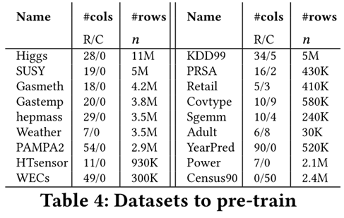
Pre-training strategies
Follow AI pre-training to:
Use a large corpus of datasets
Augment/Enrich the frequency & correlation
patterns for better training variety.
One-time pre-training w/ 10s of Ks of datasets on 4 x NVidia V100 GPUs, 1 day.

Slide 15
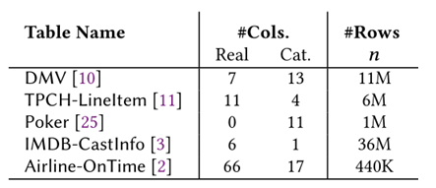
Experiments
Metrics for accuracy, building & CE costs:
Geometric Mean of Q-error (GMQ) $max⁡(\frac{pred}{gt},\frac{gt}{pred})$: [1, $+∞$] low is better,
Latency.
Baselines for CE:
Sampling,
Histograms (AVI from SQL Server),
ML-based CE:
MSCN (CIDR18), LM (VLDB19), DeepDB, Naru (VLDB20).
Testing on unseen datasets
Multipliers (0.5, 1, 2x) of the storage budget used in SQL Server.
Table 5: Unseen datasets for testing

Slide 16
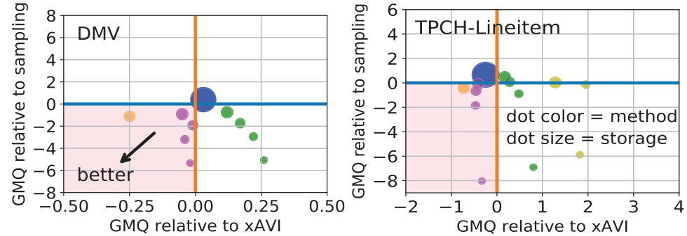
Accuracy @ different storage budgets
GMQ @ 1x | Space (KB) | Iris | SQL Server (AVI) | Sampling | LM- | MSCN | Naru | DeepDB
DMV | 80 (1x) | 1.60 | 1.61 | 3.52 | 1.78 | 10.79 | x | x
TPCH-Lineitem | 60 (1x) | 1.67 | 2.13 | 2.33 | 2.41 | 36.13 | x | x
Poker | 44 (1x) | 1.03 | 1.03 | 1.57 | 1.85 | 25.28 | 6.4K | 1.14
IMDB-CastInfo | 28 (1x) | 2.49 | 2.38 | 1.85 | 2.43 | 3.6K | x | x
Airline-OnTime | 332 (1x) | 1.33 | 1.30 | 1.28 | 1.55 | 3.59 | x | x
Iris provides similar or better accuracy
@0.5, 1x storage budget
Notes:
Some ML models require very large storage budget in MBs, and with that budget simple baselines are already very good in terms of accuracy.

Slide 17
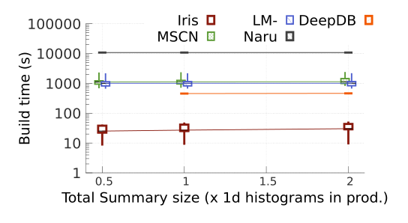
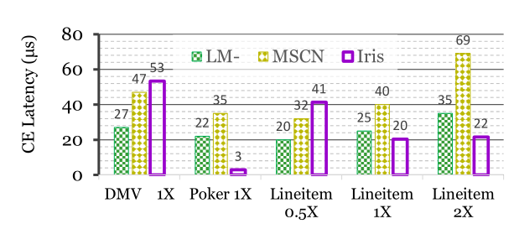
Latency @ different storage budgets
)
*All baselines use SIMD.
Iris: 1-2 orders of magnitude faster for construction.
Iris: CE per query in sub-milliseconds.

Slide 18
Conclusions
Common frequency & correlation patterns in structured datasets
Exist & can be learned in pre-training.
Can be applied to answer CE queries in unseen datasets.
Pre-training on ~20 datasets. One time cost: ~1 day on 4 GPUs
CE results on 5 single table datasets,
Up to 100x faster to build than per-dataset/workload models.
Answers a CE query in sub-millisecond.
Similar or better accuracy than sampling, SQL server histograms and CE models @ similar storage.
Summaries can be incrementally built/updated.
Code, datasets, models can be found at http://yao.lu/iris

