Slide 1
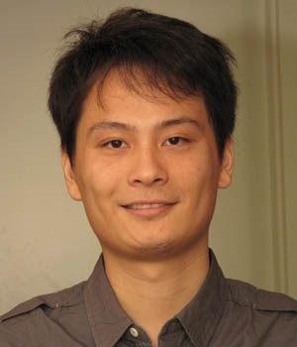
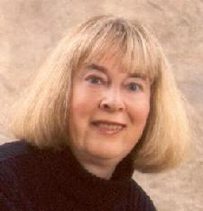
Closing the Loop for Edge Detection and Object Proposals
Yao Lu, Linda Shapiro
University of Washington
AAAI-17

Slide 2
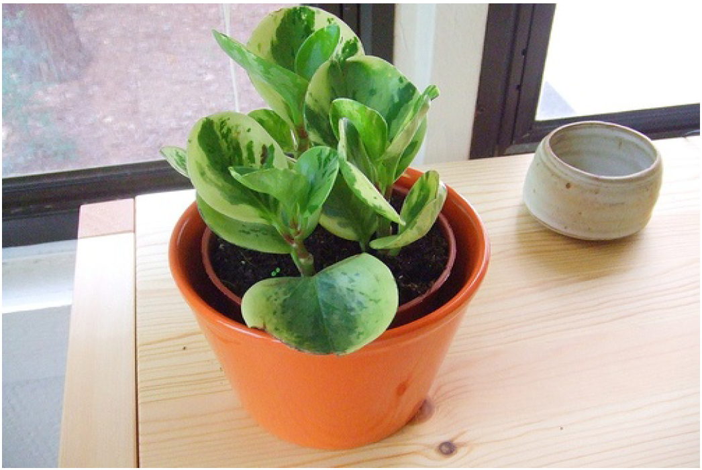
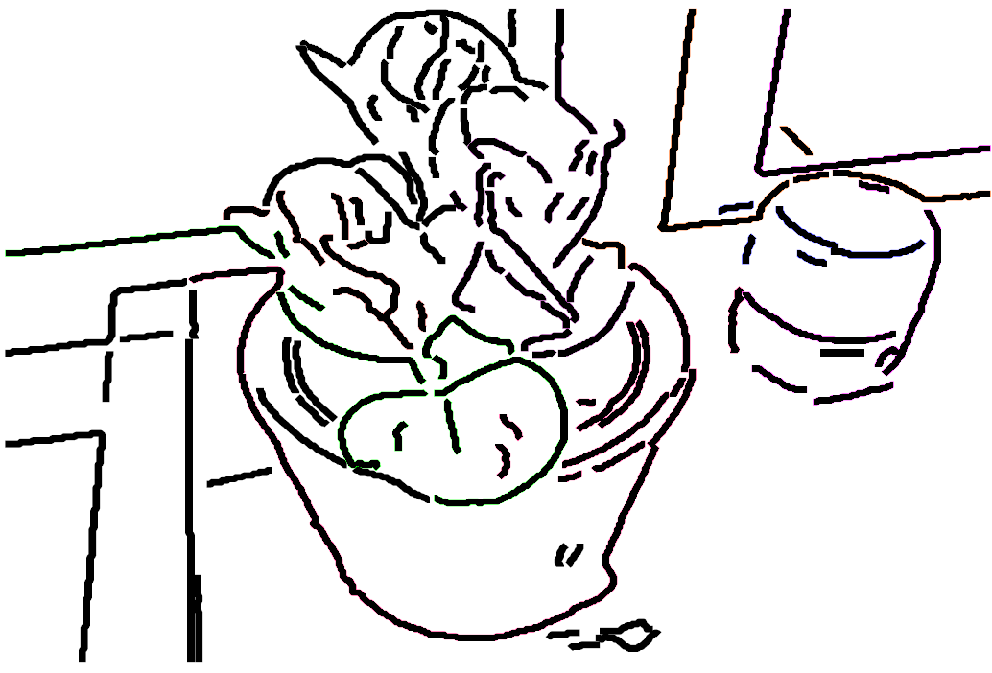
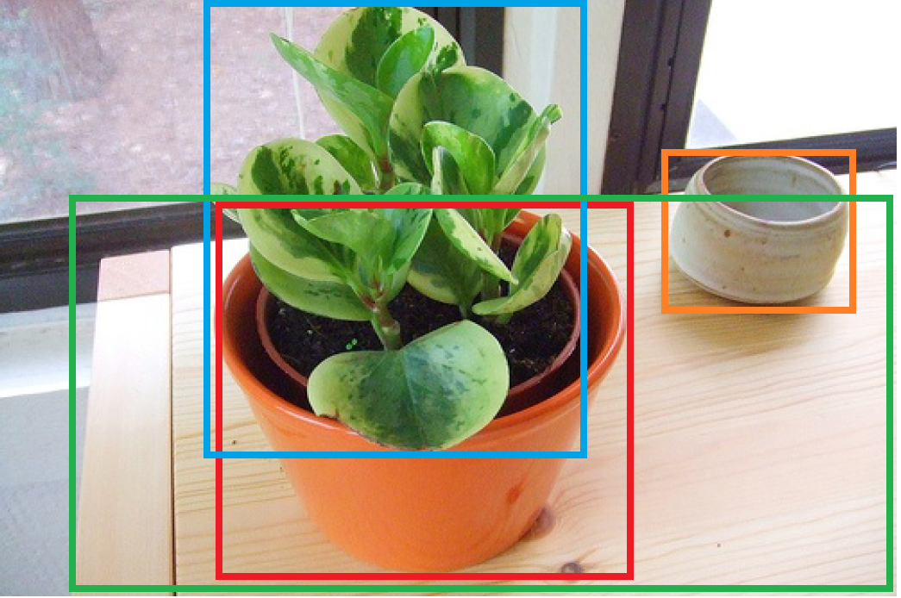
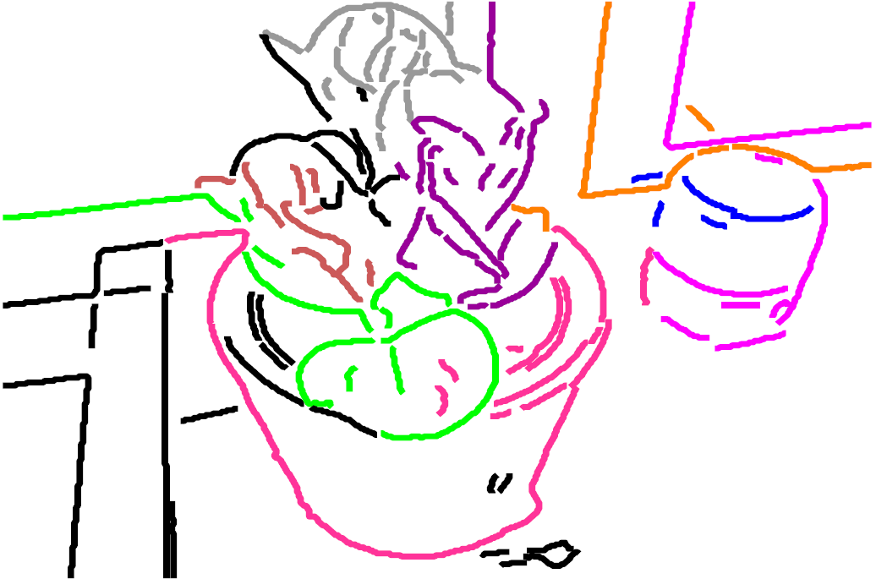
Background: human visual perception
Object perception
Edge perception
Assigning edges to regions
Grouping regions to objects
Bottom-up and top-down pathways
Ref: S. Palmer. Vision Science: Photons to Phenomenology. MIT Press 1999.

Slide 3
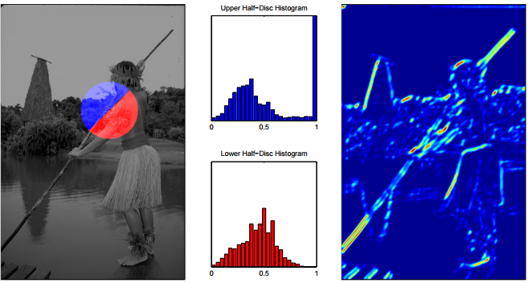
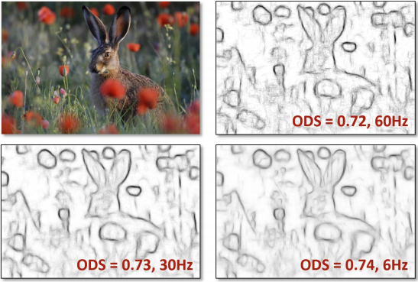
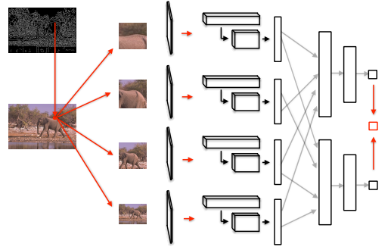
Edge detection in CV
Edge detection based on local and global image representations
Probabilistic boundaries (gPb) [P. Arbelaez et al. PAMI 2011].
Structural Edges [P. Dollar et al. ICCV2013].
Deep Edges. [G Bertasius et al. CVPR2015].

Slide 4
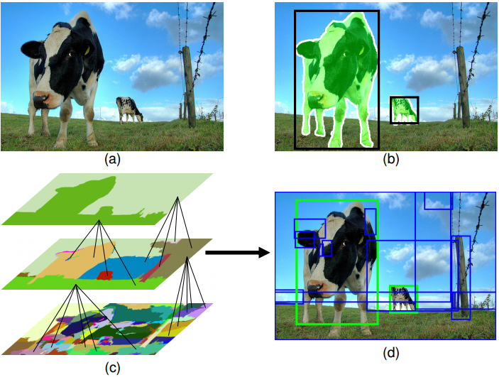
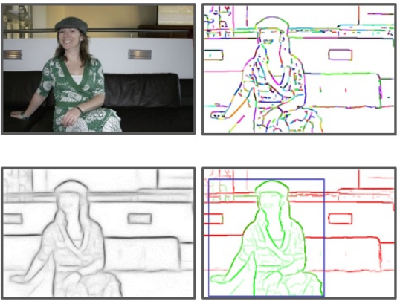
Object proposals in CV
Object proposals suggest object candidates to simplify detection.
Current methods based on edges and segmentation:
Selective Search [K. van de Sande et al. ICCV2011].
EdgeBox [CW Zitnick et al. ECCV2014]
Object proposals based on DNNs:
Faster RCNN [S Ren et al. NIPS2015]

Slide 5
Bootstrap edges and object proposals?
Edge detection and object proposals are independent tasks
in current CV.
Ignoring feedback from objects to edges.
Closing the loop for edges and objects proposals?
Benefit individual tasks
Challenges for closing-the-loop
How can edges improve object proposals?
How can class-agnostic object proposals help edge detection?
How to bootstrap edges and object proposals?
Edges
Object Proposals
?

Slide 6
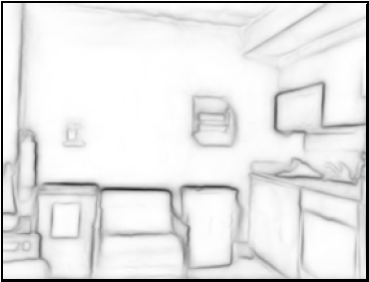
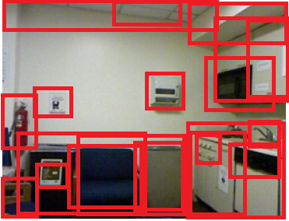
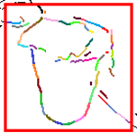
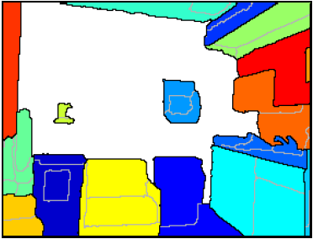
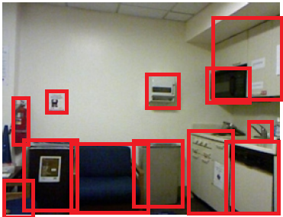
Closing-the-loop framework
Boundaries
Edge-based
proposal
Initial object proposals
Closed contour
extraction
Local closed contours
Retrained
edge detector
Proposal to boundary
Retrained
edge detector
Scoring and
reranking
Boundary to proposal
Global object hierarchies
Proposal box
Grouping
Refined object proposals
Boundary-to-proposal pipeline
Proposal-to-boundary pipeline

Slide 7
Closing-the-loop framework
Boundaries
Edge-based
proposal
Initial object proposals
Closed contour
extraction
Local closed contours
Retrained
edge detector
Proposal to boundary
Scoring and
reranking
Boundary to proposal
Global object hierarchies
Proposal box
Grouping
Refined object proposals
Boundary-to-proposal pipeline
Proposal-to-boundary pipeline

Slide 8
Closing-the-loop framework
Boundary-to-proposal pipeline
Proposal-to-boundary pipeline
Boundaries
Edge-based
proposal
Initial object proposals
Closed contour
extraction
Local closed contours
Retrained
edge detector
Proposal to boundary
Scoring and
reranking
Boundary to proposal
Global object hierarchies
Proposal box
Grouping
Refined object proposals

Slide 9
Closing-the-loop framework
Proposal-to-boundary pipeline
Boundary-to-proposal pipeline
Starting the loop: Structure Edge & EdgeBox
Closed contours
Boundaries
Edge-based
proposal
Initial object proposals
Closed contour
extraction
Local closed contours
Retrained
edge detector
Proposal to boundary
Scoring and
reranking
Begin
Boundary to proposal
Global object hierarchies
Proposal box
Grouping
Refined object proposals

Slide 10
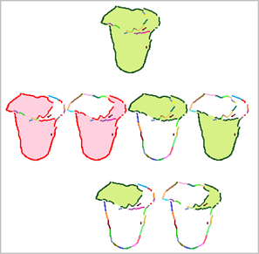
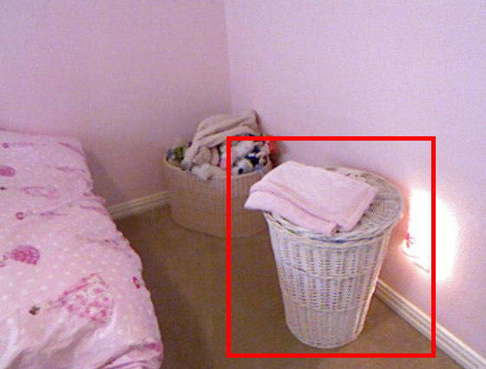
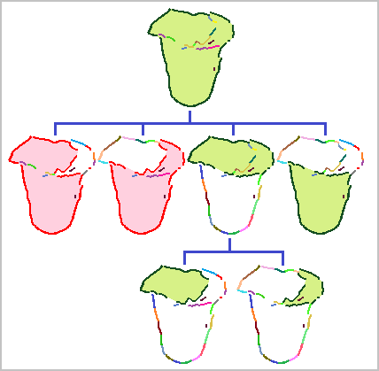
Closed contours
Extraction steps:
Group edges according to their orientation and strength
For a given proposal box, find set of edge groups that
form a closed contour,
lie totally within the box.
Local closed contour hierarchy

Slide 11
Edges to object proposals
Boundaries
Edge-based
proposal
Initial object proposals
Closed contour
extraction
Local closed contours
Retrained
edge detector
Proposal to boundary
Scoring and
reranking
Begin`
Boundary to proposal
Global object hierarchies
Proposal box
Grouping
Refined object proposals
Boundary-to-proposal pipeline
Boundary to initial proposals
Closed contour extraction
Objectness metric & reranking
Refined object proposals
Proposal-to-boundary pipeline

Slide 12
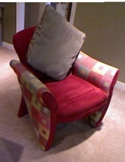
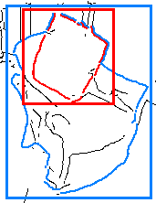
What is a good proposal?
Objectness metric
Size: Object should occupy most of the box.
Intensity: Strong edges on the border, weak edges inside.
objectness (box) = ${Max}_{c}\frac{area\left(closed contour\right)}{area(box)}⋅\frac{intensity\left(On closed contour\right)}{intensity(In closed contour)}$\
c = all closed contours in the box

Slide 13
Object proposals to edges
Boundaries
Edge-based
proposal
Initial object proposals
Closed contour
extraction
Local closed contours
Retrained
edge detector
Proposal to boundary
Scoring and
reranking
Begin
Boundary to proposal
Global object hierarchies
Proposal box
Grouping
Refined object proposals
Boundary-to-proposal pipeline
Proposal-to-boundary pipeline
Grouping refined object proposals
Hierarchical segmentations construction
Refined edges

Slide 14
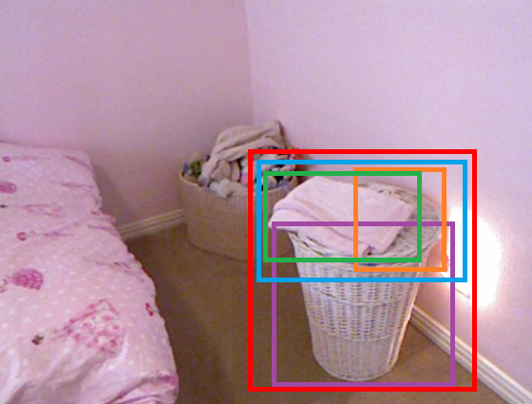
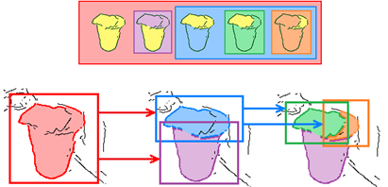
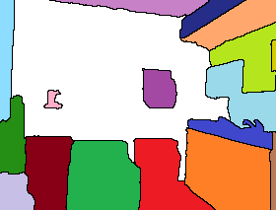
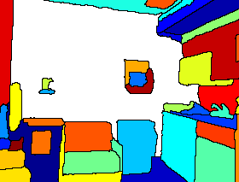
Grouping proposal boxes
Class-agnostic proposals object hierarchies
Object hierarchies hierarchical segmentations
Training edge detectors with addition feature channels

Slide 15
Evaluations
Datasets
PASCAL VOC 2012 (RGB)
NYU-D (RGB-D)
Metrics
Edge detection: ODS, OIS, AP
Object proposal: Recall/# of proposals, AUC

Slide 16
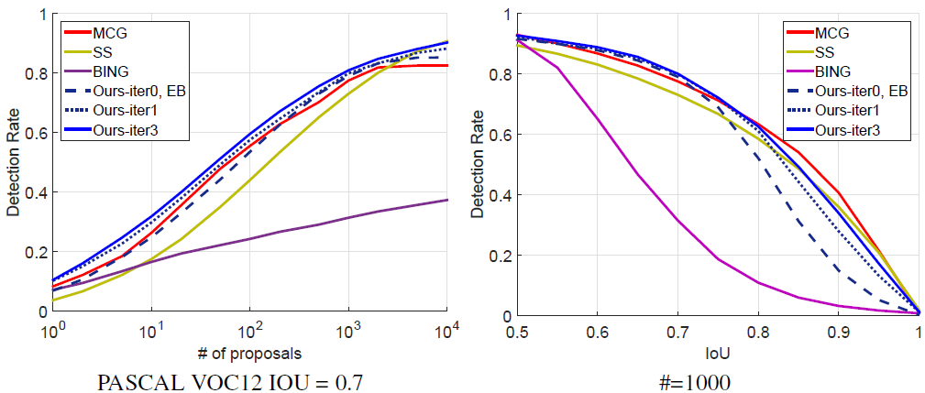
Evaluations – object proposals
Comparisons on PASCAL VOC12
SS: Selective search
MCG: [Arbelaez et al. CVPR14.]
BING: [Cheng et al. CVPR14.]
EB: EdgeBox

Slide 17
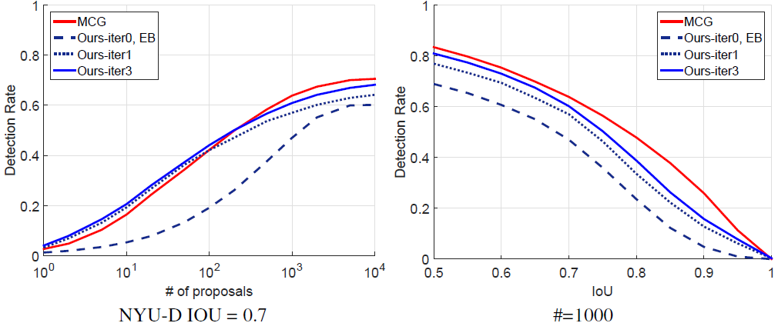
Evaluations – object proposals
Comparisons on NYU-D
SS: Selective search
MCG: [Arbelaez et al. CVPR14.]
BING: [Cheng et al. CVPR14.]
EB: EdgeBox

Slide 18
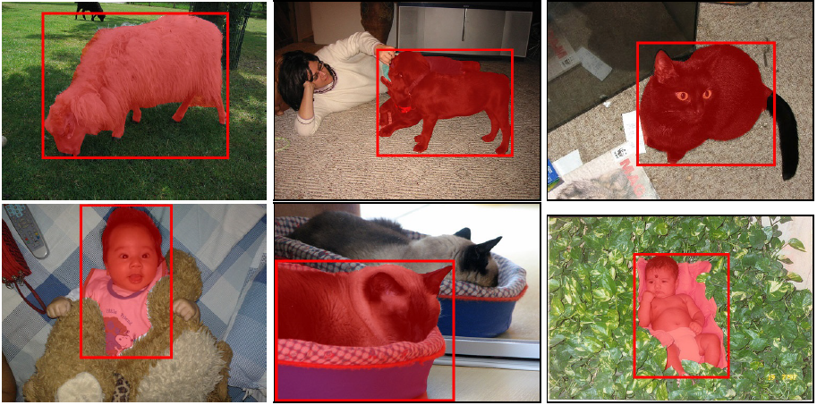
Evaluations – object proposals
SS: Selective search
MCG: [Arbelaez et al. CVPR14.]
BING: [Cheng et al. CVPR14.]
EB: EdgeBox

Slide 19
Evaluations – edges
 | BSD500 |  |  | NYUD
Method | ODS | OIS | AP | ODS | OIS | AP
gPb | 0.71 | 0.74 | 0.65 | 0.63 | 0.66 | 0.56
SC | 0.74 | 0.76 | 0.77 | 0.64 | 0.67 | 0.57
SE+ | - | - | - | 0.70 | 0.72 | 0.69
N4-field | 0.75 | 0.77 | 0.78 | - | - | -
DeepEdge | 0.75 | 0.77 | 0.81 | - | - | -
Ours-iter0, SE | 74 | 76 | 78 | 69 | 69 | 68
Ours-iter1 | 75 | 76 | 79 | 71 | 72 | 72
Ours-iter2 | 75 | 77 | 80 | 71 | 74 | 73
Ours-iter3 | 75 | 77 | 80 | 72 | 74 | 74
gPb: [Arbelaez et al. PAMI11]
SC: [Ren et al. NIPS12]
SE+: [Gupta et al. CVPR13]
N4-field: [Ganin et al. ACCV14]
DeepEdge: [Bertasius etal. CVPR15]
SE: [Dollar et al. ICCV13]

Slide 20
Evaluations – closing-the-loop
MCG: [Arbelaez et al. CVPR14.]
SC: [Ren et al. NIPS12]
SE: [Dollar et al. ICCV13]

Slide 21
Conclusion
Object proposals and edges can benefit one another.
Speed: 6-10 sec/image (Matlab/C)
Questions? luyao@cs.washington.edu

